Slide 1



Introduction to Baidu and Yandex Search Engines
Baidu and Yandex are dominant search engines in their respective regions: China and Russia. They are sophisticated platforms built to handle massive amounts of data and deliver relevant search results.
by piragenth satkunananthan

Slide 2
Origin and History
Baidu, founded in 2000, is China's largest search engine. Yandex, launched in 1997, is Russia's leading search engine.
Baidu
Yandex
Initially focused on providing search services, Baidu expanded to include other services such as cloud computing and artificial intelligence.
Yandex also branched out into other areas like online advertising, maps, and email services.

Slide 3

Total Number of Employees and Duties
Both Baidu and Yandex employ thousands of skilled professionals across various departments. Their responsibilities range from research and development to marketing and customer support.
Company
Employees
Duties
Baidu
Over 20,000
Software Engineers, Data Analysts, Marketing Specialists, Customer Service Representatives
Yandex
Over 15,000
Software Developers, Data Scientists, Product Managers, Business Development Managers

Slide 4

Employee Benefits
Both companies strive to provide their employees with competitive benefits, aiming to attract and retain top talent.
1
Health Insurance
Comprehensive health coverage, including medical, dental, and vision.
2
Paid Time Off
Generous vacation time and sick leave policies.
3
Retirement Plan
401k or similar retirement savings plan with employer matching contributions.
4
Professional Development
Tuition reimbursement and opportunities for ongoing training and skill development.

Slide 5

Backup Time and Processes
Both Baidu and Yandex implement robust backup systems to ensure data integrity and minimal downtime in the event of failures. Regular backups are performed, often on a daily or hourly basis.
1
Data Replication
Multiple copies of data are stored in geographically dispersed locations to prevent data loss.
2
Backup Scheduling
Automated backups are scheduled to run at specific intervals to minimize data loss in case of failures.
3
Data Verification
Backups are regularly checked to ensure data integrity and recoverability.

Slide 6
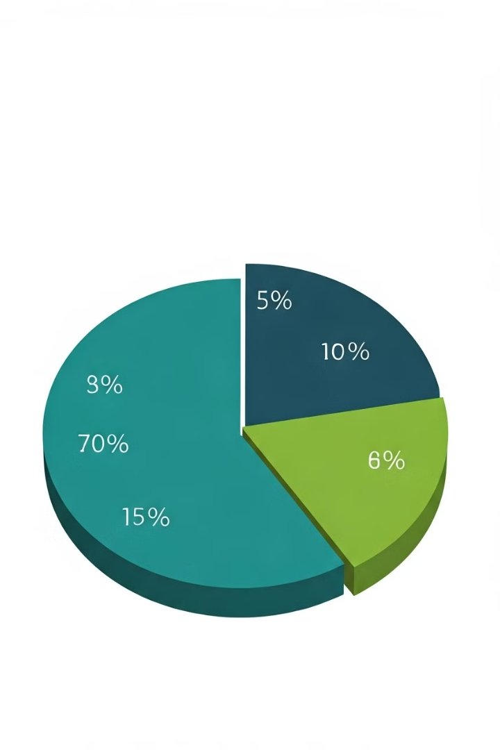



Common Failures and Search Percentages
Common failures in search engines can include network outages, server crashes, and indexing errors. Both Baidu and Yandex have high search percentages, reflecting their dominance in their respective regions.
Network Outages
Interruptions in network connectivity can lead to service disruptions.
Server Crashes
Hardware failures or software bugs can cause servers to malfunction.
Indexing Errors
Inaccurate or incomplete indexing can result in irrelevant or missing search results.

Slide 7





Server Configuration and Infrastructure
Both companies invest heavily in high-performance server infrastructure to handle the immense volume of search queries and data storage.
Cloud Computing
Utilize cloud-based solutions for scalability and flexibility, enabling them to adapt to changing demand.
Database Management
Employ robust database systems to efficiently store and retrieve vast amounts of information.
Network Optimization
Optimize their network infrastructure for low latency and high bandwidth, ensuring fast and reliable search results.
Security Measures
Implement comprehensive security measures to protect sensitive user data and prevent unauthorized access.

Slide 8

User Interest and Engagement
Both Baidu and Yandex have garnered significant user interest and engagement in their respective regions, owing to their comprehensive search capabilities and additional services.
Localization
Offer tailored search results and services that cater to local interests and preferences.
Innovation
Continuously develop new features and technologies to enhance user experience and meet evolving search needs.
User-Friendly Interface
Provide intuitive and user-friendly interfaces that are accessible to a wide range of users.

Slide 9




Data Search, Backup, Security, and Privacy Techniques
Both Baidu and Yandex employ advanced data search, backup, security, and privacy techniques to ensure data integrity, reliability, and user trust.
Data Search
Data Backup
Data Security
Data Privacy
Implement sophisticated algorithms to analyze vast amounts of data and deliver relevant search results.
Employ robust backup systems to protect data from loss or corruption.
Implement robust security measures to prevent unauthorized access and data breaches.
Adhere to strict privacy policies and employ privacy-enhancing technologies to protect user data.

